Slide 1
\LaTeX
For Scientific Documentation
By Ammar Taha Mohamedy
Index Formatting

Slide 2
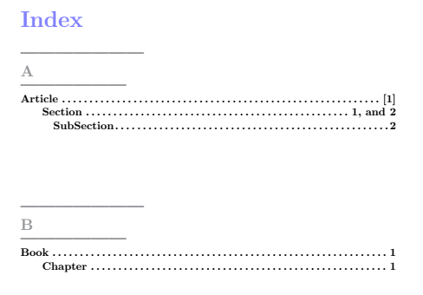
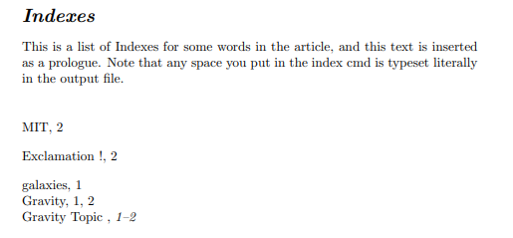
Index Style Files
Index_format.ist
Key / Value
….
….
Key / Value

Slide 3
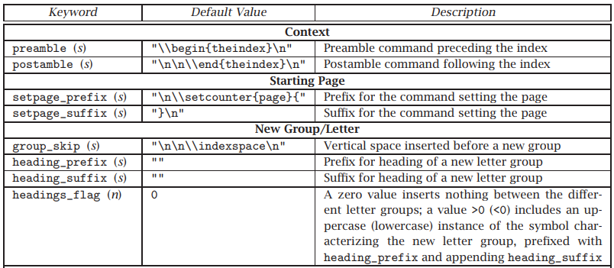
Style Parameters
Refer to the Folder: MakeIndex - mankier.com
Index Preparation and Processing

Slide 4
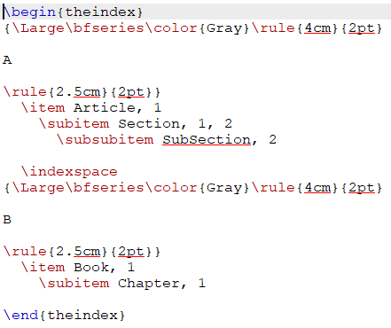
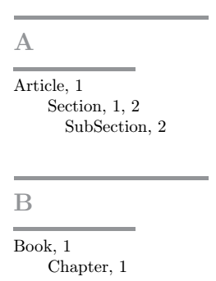
Formatting Example: using the \rule{width}{thickness}
Using the rule
heading_prefix “{\\Large\\bfseries\\color{Gray}\\rule{4cm}{2pt}\n\n"
heading_suffix "\n\n\\rule{2.5cm}{2pt}}"
.ist
\n
\n
.ind

Slide 5
Formatting Scopes
The prefix inserted macros end before the letter, and the suffix macros start after the letter, and both of them encapsulate the letter.
heading_prefix “ [Applies before the Group Letter] {Encapsulates”
heading_suffix “The Letter} (Applies after the Group Letter) ”
Generally:
The placement of group {} braces affects the result in the output.

Slide 6
Thanks for Watching !!

